Slide 1


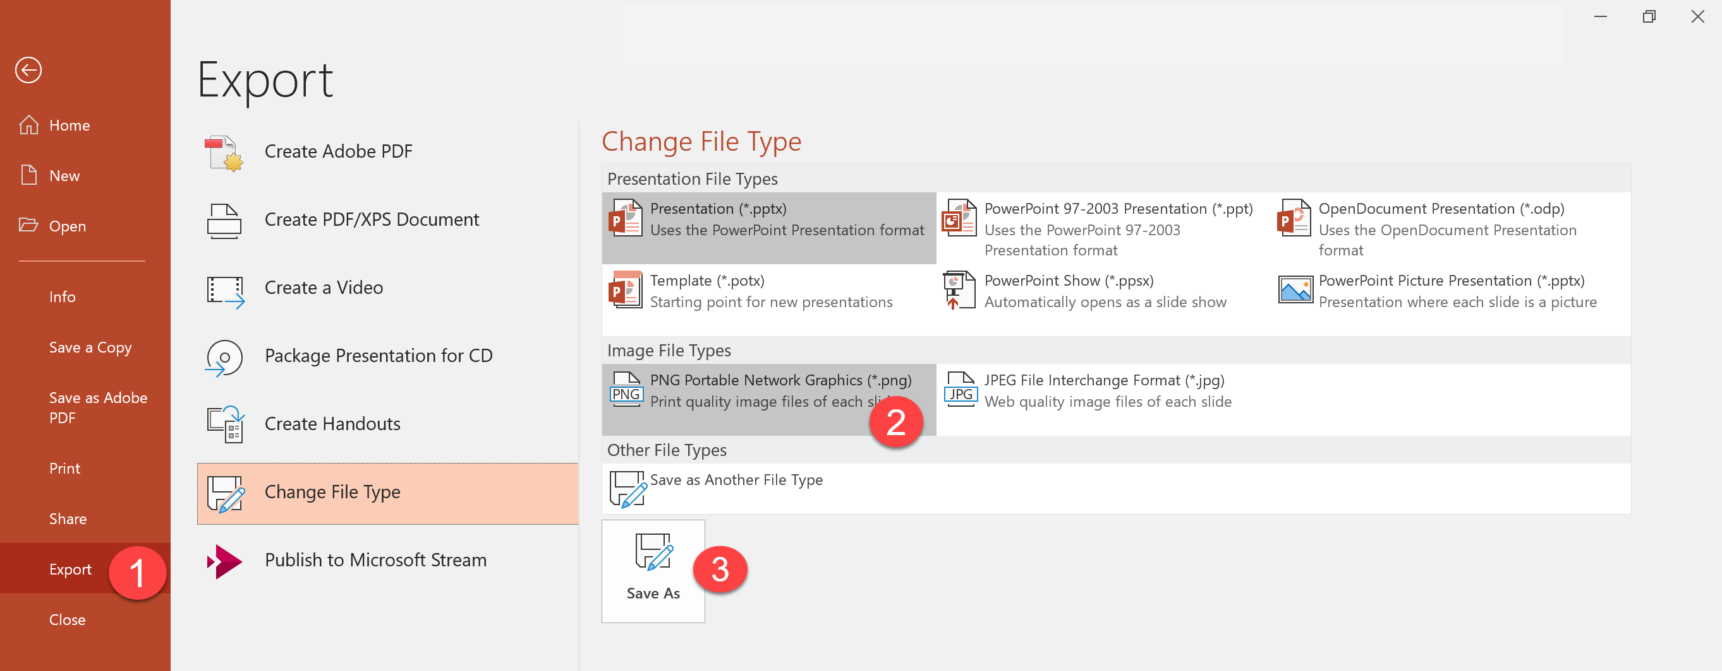
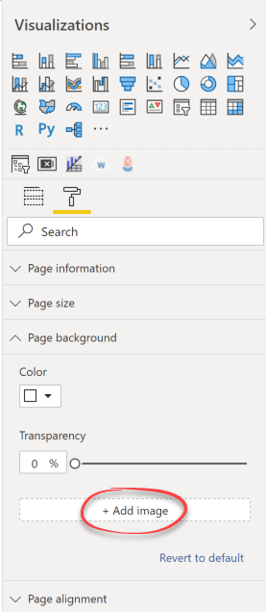
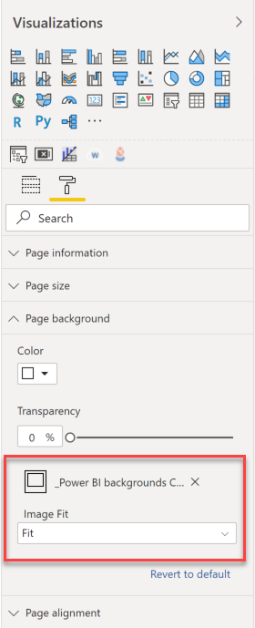
1. Export the pages to PNG images.
2. Add the images to the page background of the Power BI pages and set the Image Fit to Fit.

Slide 4


















